Slide 1
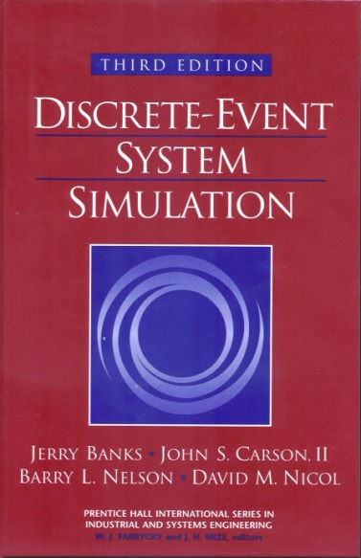
DISCRETE-EVENT SYSTEM SIMULATION
Third Edition
Jerry Banks • John S. Carson II
Barry L. Nelson • David M. Nicol

Slide 2
Ch. 1 Introduction to Simulation
Real-world process
A set of assumptions
Modeling & Analysis
concerning the behavior of a system
Simulation
the imitation of the operation of a real-world process or system over time
to develop a set of assumptions of mathematical, logical, and symbolic relationship between the entities of interest, of the system.
to estimate the measures of performance of the system with the simulation-generated data
Simulation modeling can be used
as an analysis tool for predicting the effect of changes to existing systems
as a design tool to predict the performance of new systems

Slide 3
1.1 When Simulation is the Appropriate Tool (1)
Simulation enables the study of, and experimentation with, the internal interactions of a complex system, or of a subsystem within a complex system.
Informational, organizational, and environmental changes can be simulated, and the effect of these alterations on the model’s behavior can be observed.
The knowledge gained in designing a simulation model may be of great value toward suggesting improvement in the system under investigation.
By changing simulation inputs and observing the resulting outputs, valuable insight may be obtained into which variables are most important and how variables interact.
Simulation can be used as a pedagogical device to reinforce analytic solution methodologies.

Slide 4
1.1 When Simulation is the Appropriate Tool (2)
Simulation can be used to experiment with new designs or policies prior to implementation, so as to prepare for what may happen.
Simulation can be used to verify analytic solutions.
By simulating different capabilities for a machine, requirements can be determined.
Simulation models designed for training allow learning without the cost and disruption of on-the-job learning.
Animation shows a system in simulated operation so that the plan can be visualized.
The modern system (factory, wafer fabrication plant, service organization, etc.) is so complex that the interactions can be treated only through simulation.

Slide 5
1.2 When Simulation is not Appropriate
When the problem can be solved using common sense.
When the problem can be solved analytically.
When it is easier to perform direct experiments.
When the simulation costs exceed the savings.
When the resources or time are not available.
When system behavior is too complex or can’t be defined.
When there isn’t the ability to verify and validate the model.

Slide 6
1.3 Advantages and Disadvantages of Simulation (1)
Advantages
New polices, operating procedures, decision rules, information flows, organizational procedures, and so on can be explored without disrupting ongoing operations of the real system.
New hardware designs, physical layouts, transportation systems, and so on, can be tested without committing resources for their acquisition.
Hypotheses about how or why certain phenomena occur can be tested for feasibility.
Insight can be obtained about the interaction of variables.
Insight can be obtained about the importance of variables to the performance of the system.
Bottleneck analysis can be performed indicating where work-in-process, information, materials, and so on are being excessively delayed.
A simulation study can help in understanding how the system operates rather than how individuals think the system operates.
“What-if” questions can be answered. This is particularly useful in the design of new system.

Slide 7
1.3 Advantages and Disadvantages of Simulation (2)
Disadvantages
Model building requires special training. It is an art that is learned over time and through experience. Furthermore, if two models are constructed by two competent individuals, they may have similarities, but it is highly unlikely that they will be the same.
Simulation results may be difficult to interpret. Since most simulation outputs are essentially random variables (they are usually based on random inputs), it may be hard to determine whether an observation is a result of system interrelationships or randomness.
Simulation modeling and analysis can be time consuming and expensive. Skimping on resources for modeling and analysis may result in a simulation model or analysis that is not sufficient for the task.
Simulation is used in some cases when an analytical solution is possible, or even preferable, as discussed in Section 1.2. This might be particularly true in the simulation of some waiting lines where closed-form queueing models are available.

Slide 8
1.4 Areas of Application (1)
WSC(Winter Simulation Conference) : http://www.wintersim.org
Manufacturing Applications
Analysis of electronics assembly operations
Design and evaluation of a selective assembly station for high-precision scroll compressor shells
Comparison of dispatching rules for semiconductor manufacturing using large-facility models
Evaluation of cluster tool throughput for thin-film head production
Determining optimal lot size for a semiconductor back-end factory
Optimization of cycle time and utilization in semiconductor test manufacturing
Analysis of storage and retrieval strategies in a warehouse
Investigation of dynamics in a service-oriented supply chain
Model for an Army chemical munitions disposal facility
Semiconductor Manufacturing
Comparison of dispatching rules using large-facility models
The corrupting influence of variability
A new lot-release rule for wafer fabs

Slide 9
1.4 Areas of Application (2)
Assessment of potential gains in productivity due to proactive reticle management
Comparison of a 200-mm and 300-mm X-ray lithography cell
Capacity planning with time constraints between operations
300-mm logistic system risk reduction
Construction Engineering
Construction of a dam embankment
Trenchless renewal of underground urban infrastructures
Activity scheduling in a dynamic, multiproject setting
Investigation of the structural steel erection process
Special-purpose template for utility tunnel construction
Military Application
Modeling leadership effects and recruit type in an Army recruiting station
Design and test of an intelligent controller for autonomous underwater vehicles
Modeling military requirements for nonwarfighting operations
Multitrajectory performance for varying scenario sizes
Using adaptive agent in U.S Air Force pilot retention

Slide 10
1.4 Areas of Application (3)
Logistics, Transportation, and Distribution Applications
Evaluating the potential benefits of a rail-traffic planning algorithm
Evaluating strategies to improve railroad performance
Parametric modeling in rail-capacity planning
Analysis of passenger flows in an airport terminal
Proactive flight-schedule evaluation
Logistics issues in autonomous food production systems for extended-duration space exploration
Sizing industrial rail-car fleets
Product distribution in the newspaper industry
Design of a toll plaza
Choosing between rental-car locations
Quick-response replenishment

Slide 11
1.4 Areas of Application (4)
Business Process Simulation
Impact of connection bank redesign on airport gate assignment
Product development program planning
Reconciliation of business and systems modeling
Personnel forecasting and strategic workforce planning
Human Systems
Modeling human performance in complex systems
Studying the human element in air traffic control

Slide 12
1.5 Systems and System Environment
System
defined as a group of objects that are joined together in some regular interaction or interdependence toward the accomplishment of some purpose.
System Environment
changes occurring outside the system.
The decision on the boundary between the system and its environment may depend on the purpose of the study.

Slide 13
1.6 Components of a System (1)
Entity : an object of interest in the system.
Attribute : a property of an entity.
Activity : a time period of specified length.
State : the collection of variables necessary to describe the
system at any time, relative to the objectives of the
study.
Event : an instantaneous occurrence that may change the
state of the system.
Endogenous : to describe activities and events occurring
within a system.
Exogenous : to describe activities and events in an
environment that affect the system.

Slide 14
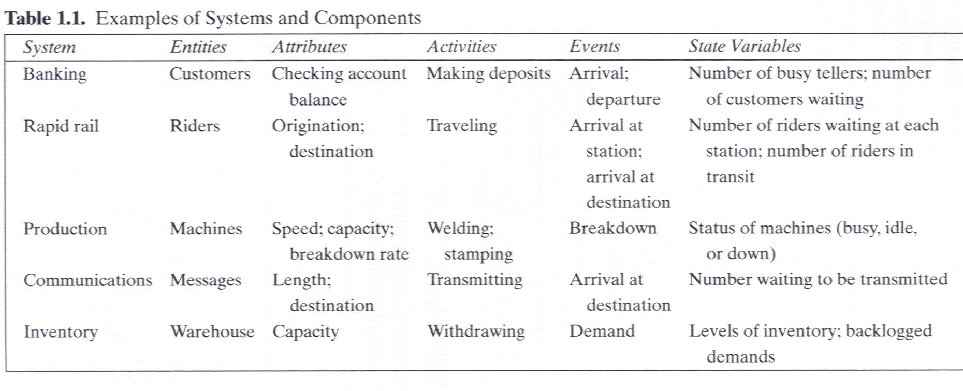
1.6 Components of a System (2)

Slide 15
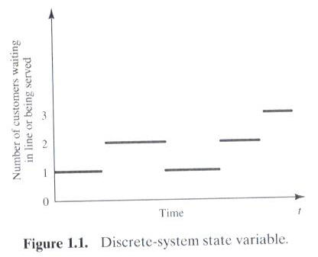
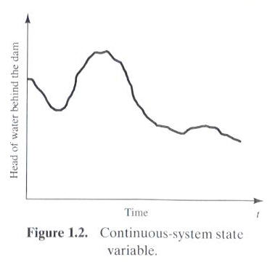
1.7 Discrete and Continuous Systems
Systems can be categorized as discrete or continuous.
Bank : a discrete system
The head of water behind a dam : a continuous system

Slide 16
1.8 Model of a System
Model
a representation of a system for the purpose of studying the system
a simplification of the system
sufficiently detailed to permit valid conclusions to be drawn about the real system

Slide 17
1.9 Types of Models
Static or Dynamic Simulation Models
Static simulation model (called Monte Carlo simulation) represents a system at a particular point in time.
The Monte Carlo simulation is a probabilistic model that can include an element of uncertainty or randomness in its prediction. When you use a probabilistic model to simulate an outcome, you will get different results each time
Dynamic simulation model represents systems as they change over time
Deterministic or Stochastic Simulation Models
Deterministic simulation models contain no random variables and have a known set of inputs which will result in a unique set of outputs
Stochastic simulation model has one or more random variables as inputs. Random inputs lead to random outputs.
The model of interest in this class is discrete, dynamic, and stochastic.

Slide 18
1.10 Discrete-Event System Simulation
The simulation models are analyzed by numerical rather than by analytical methods
Analytical methods employ the deductive reasoning of mathematics to solve the model.
Numerical methods employ computational procedures to solve mathematical models.

Slide 19
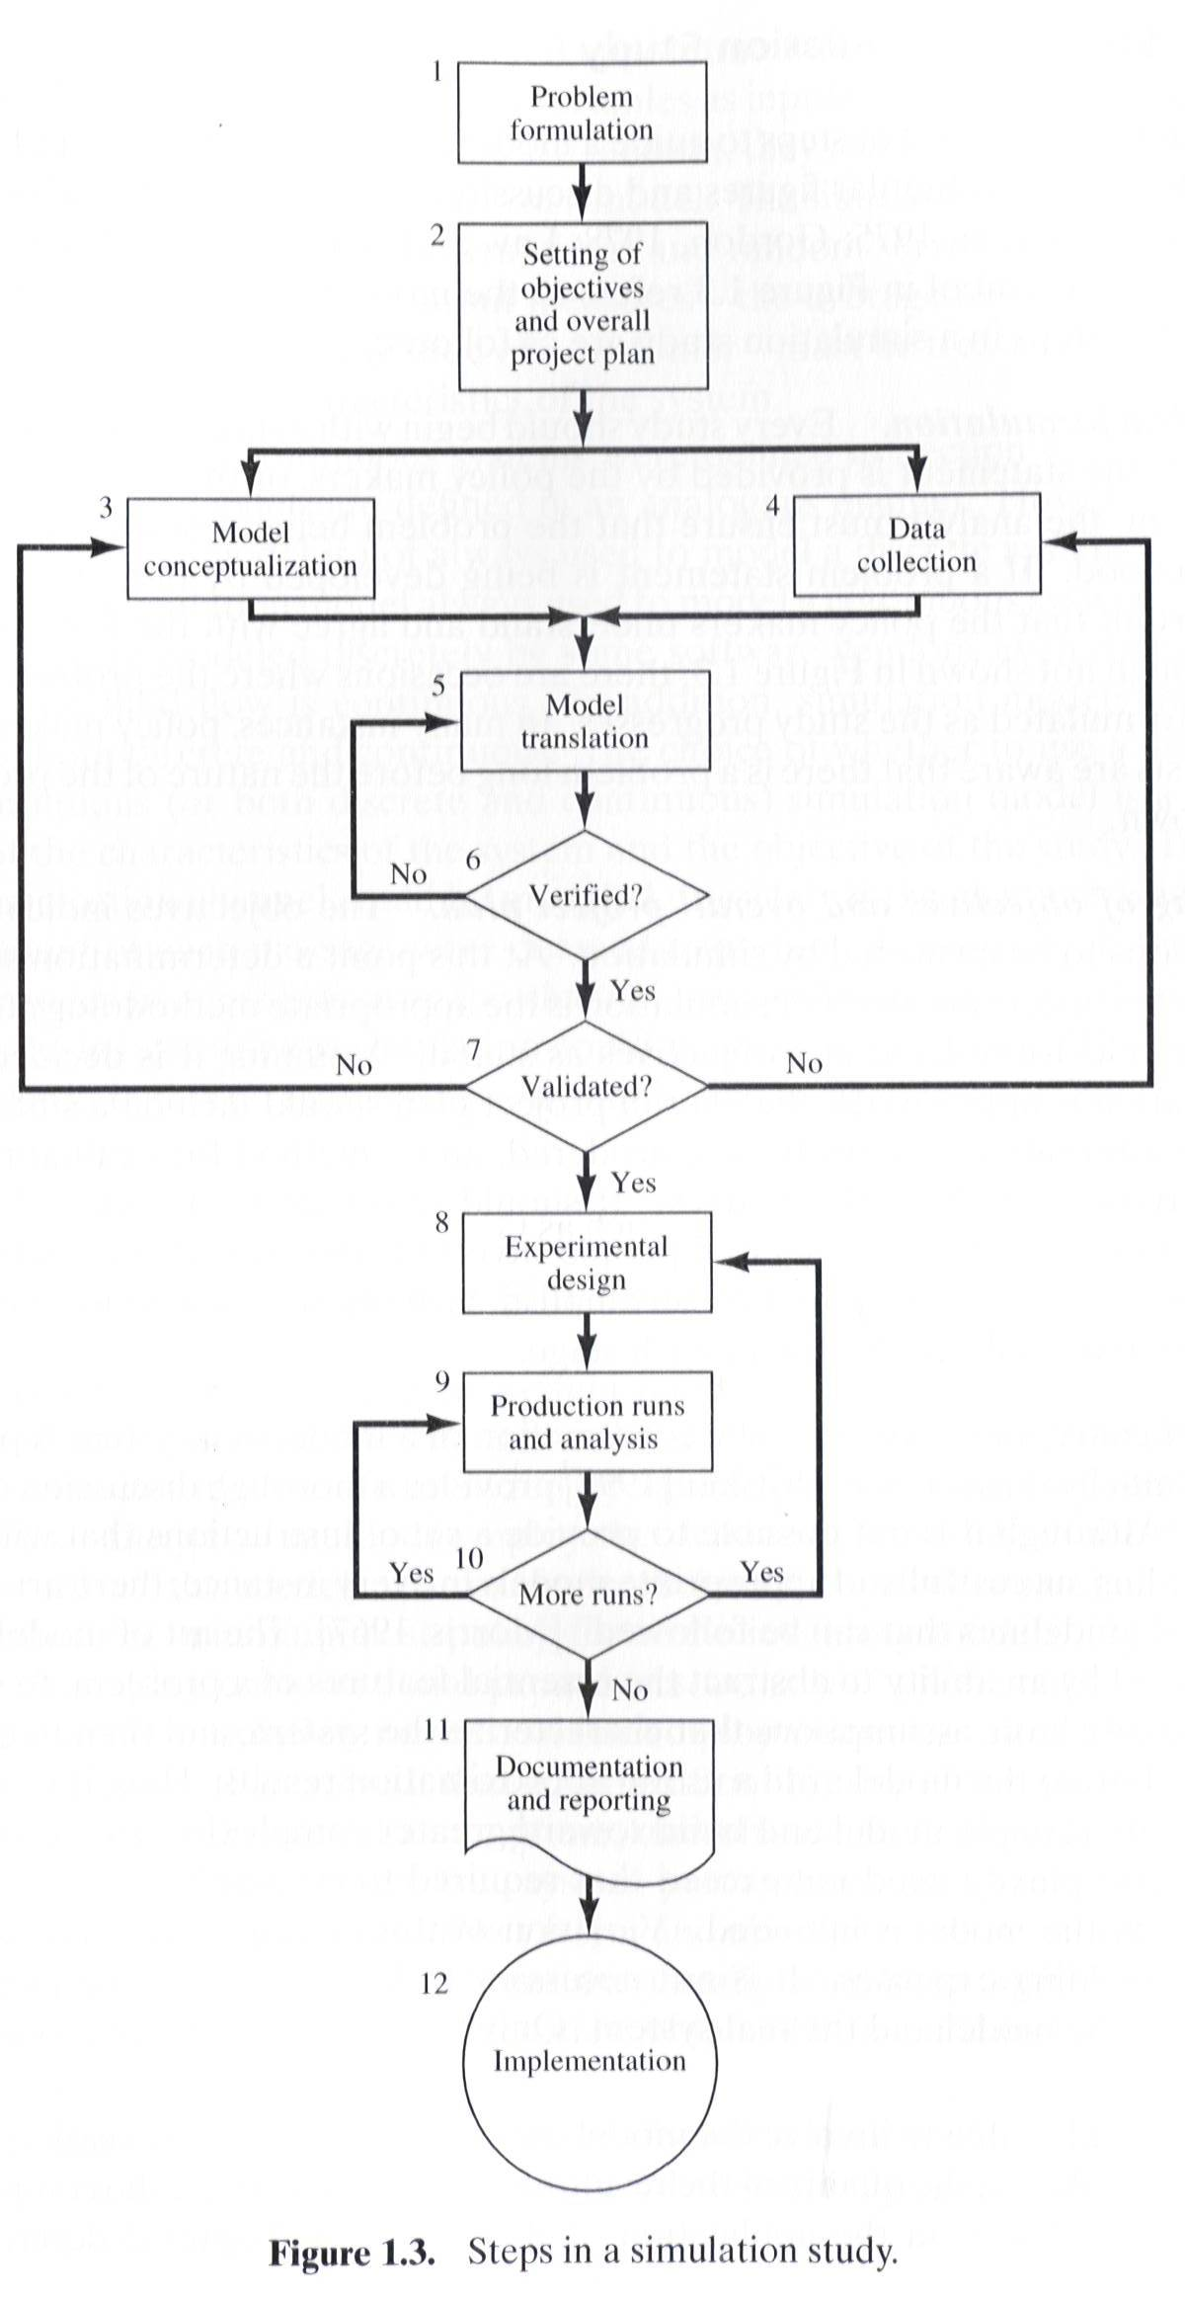

Slide 20
1.11 Steps in a Simulation Study (1)
Problem formulation
Policy maker/Analyst understand and agree with the formulation.
Setting of objectives and overall project plan
Model conceptualization
The art of modeling is enhanced by an ability to abstract the essential features of a problem, to select and modify basic assumptions that characterize the system, and then to enrich and elaborate the model until a useful approximation results.
Data collection
As the complexity of the model changes, the required data elements may also change.
Model translation
GPSS/HTM or special-purpose simulation software

Slide 21
1.11 Steps in a Simulation Study (2)
Verified?
Is the computer program performing properly?
Debugging for correct input parameters and logical structure
Validated?
The determination that a model is an accurate representation of the real system.
Validation is achieved through the calibration of the model
Experimental design
The decision on the length of the initialization period, the length of simulation runs, and the number of replications to be made of each run.
Production runs and analysis
To estimate measures of performances

Slide 22
1.11 Steps in a Simulation Study (3)
More runs?
Documentation and reporting
Program documentation : for the relationships between input parameters and output measures of performance, and for a modification
Progress documentation : the history of a simulation, a chronology of work done and decision made.
Implementation

Slide 23
1.11 Steps in a Simulation Study (4)
Four phases according to Figure 1.3
First phase : a period of discovery or orientation
(step 1, step2)
Second phase : a model building and data collection
(step 3, step 4, step 5, step 6, step 7)
Third phase : running the model
(step 8, step 9, step 10)
Fourth phase : an implementation
(step 11, step 12)

